Slide 1
SET CONNECT CAPSTONE PROJECT

Slide 2
Insight Strategists
We Are:
ANUSH BHARATHWAJ L
BALAMURUGAN B
DHATCHANA H

Slide 3
Exploratory And Data Analysis
1
Our first set of slides

Slide 4
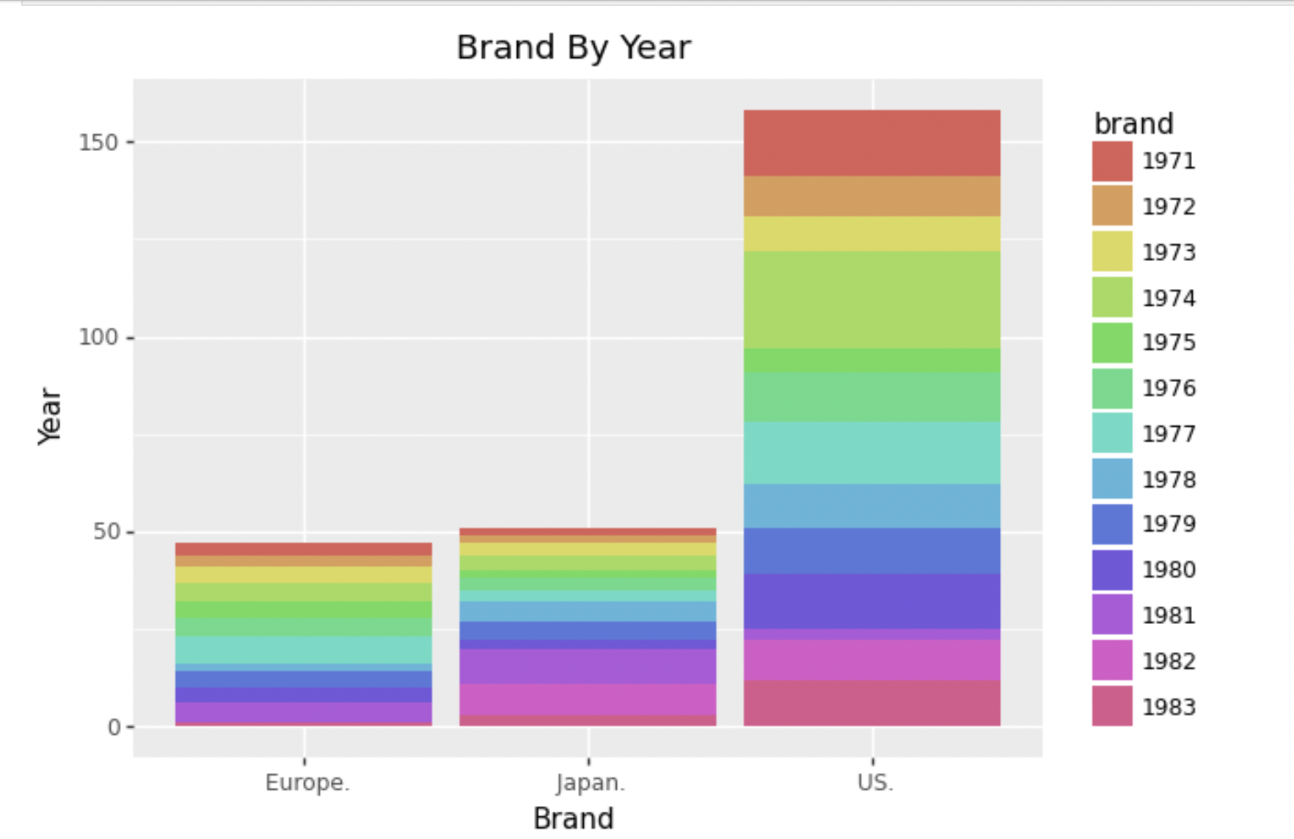
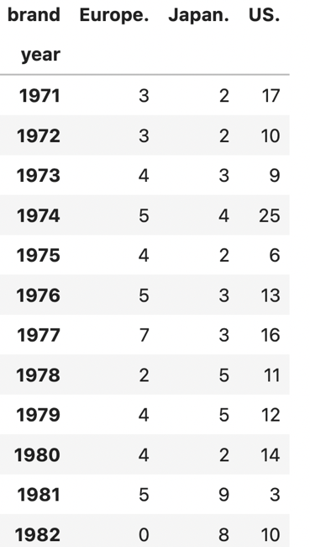
EDA
1) How do American, European, and Japanese cars differ?
GGPLOT
CROSSTAB

Slide 5
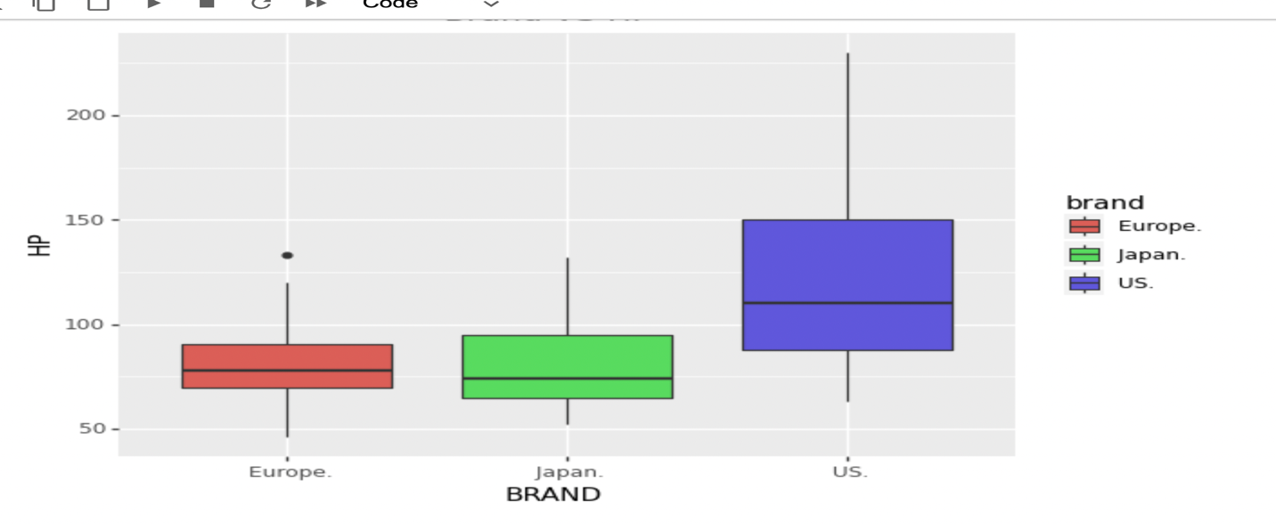
EDA
2) Add Visualization Using GGPLOT by Plotnine ?
European Produce Outlier With Respect to Hp While It was Compared To Others Japan and US. The US Holds Highest Position For The Production Of Horsepower.

Slide 6
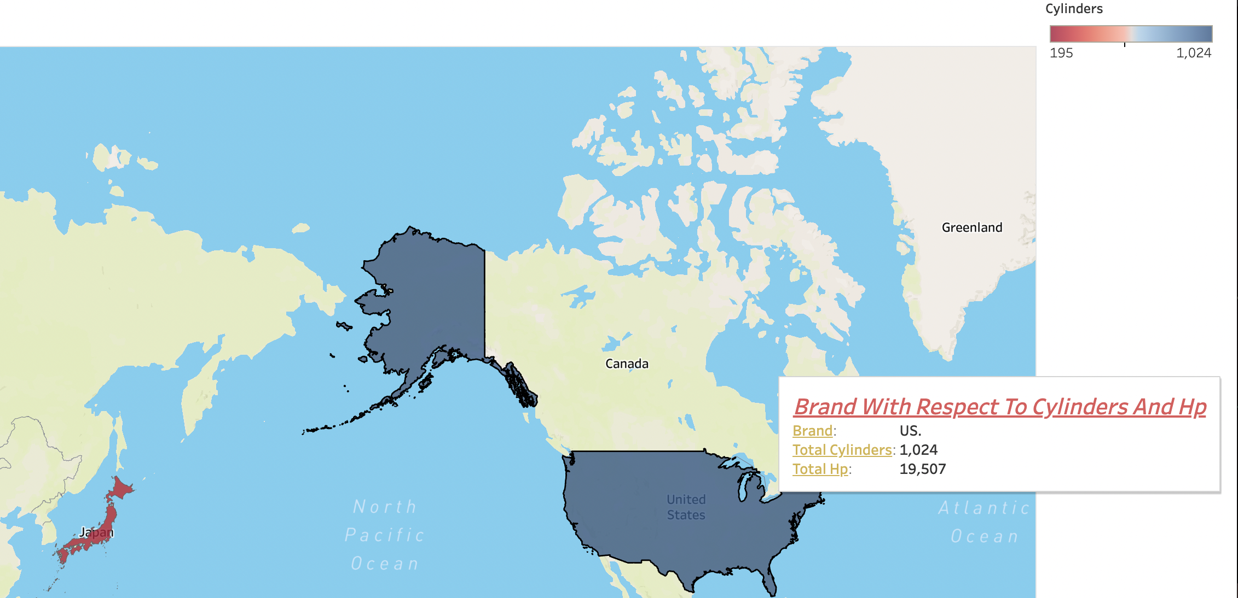
EDA
3) Visualization Using Tableau?
American’s Have More Cylinders And HP, Geographical Plot Had More Coverage For American Region Than Japan And Europe Brand.

Slide 7
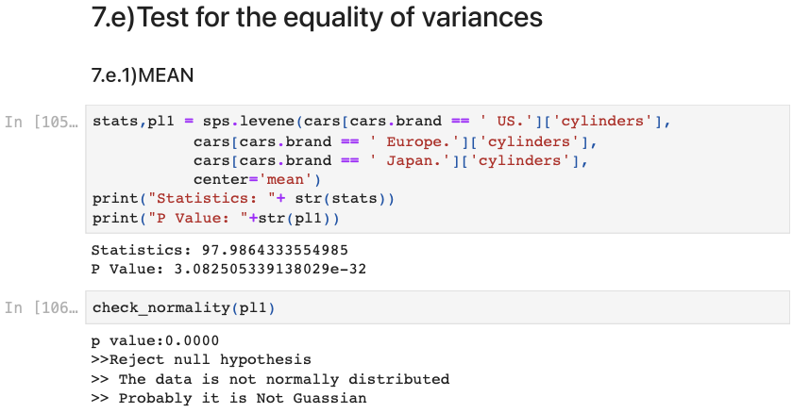
EDA
4) Statistical Testing ?
It Reject Null Hypothesis.
Where The Data Is Not Normally Distributed.
Where It Doesn’t Produce Gaussian .
It Vary Insignificantly Small In Terms Of Statistical Test .

Slide 8
Logistic Regression
2

Slide 9
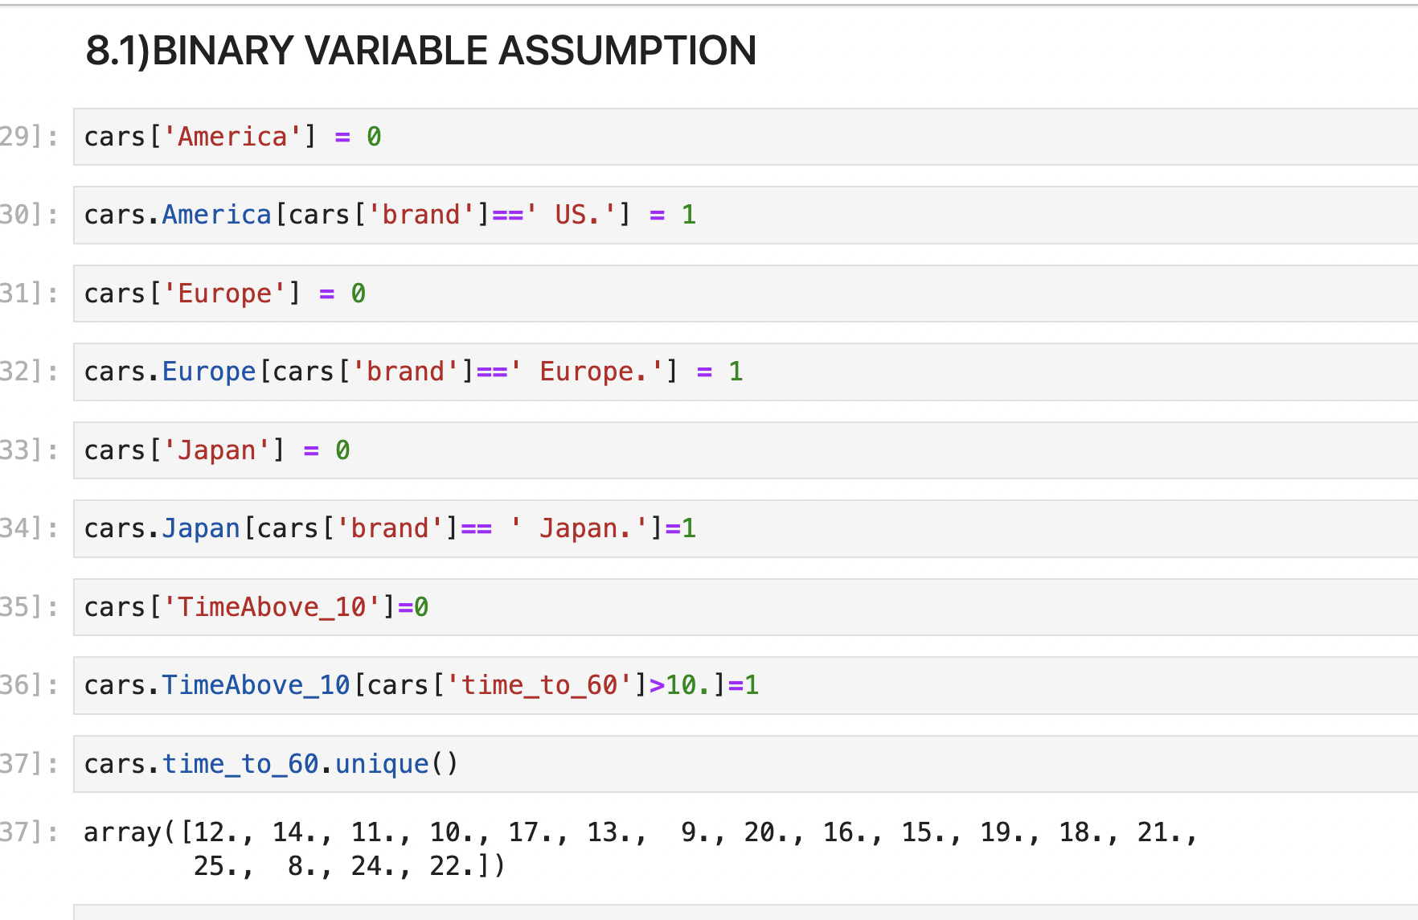
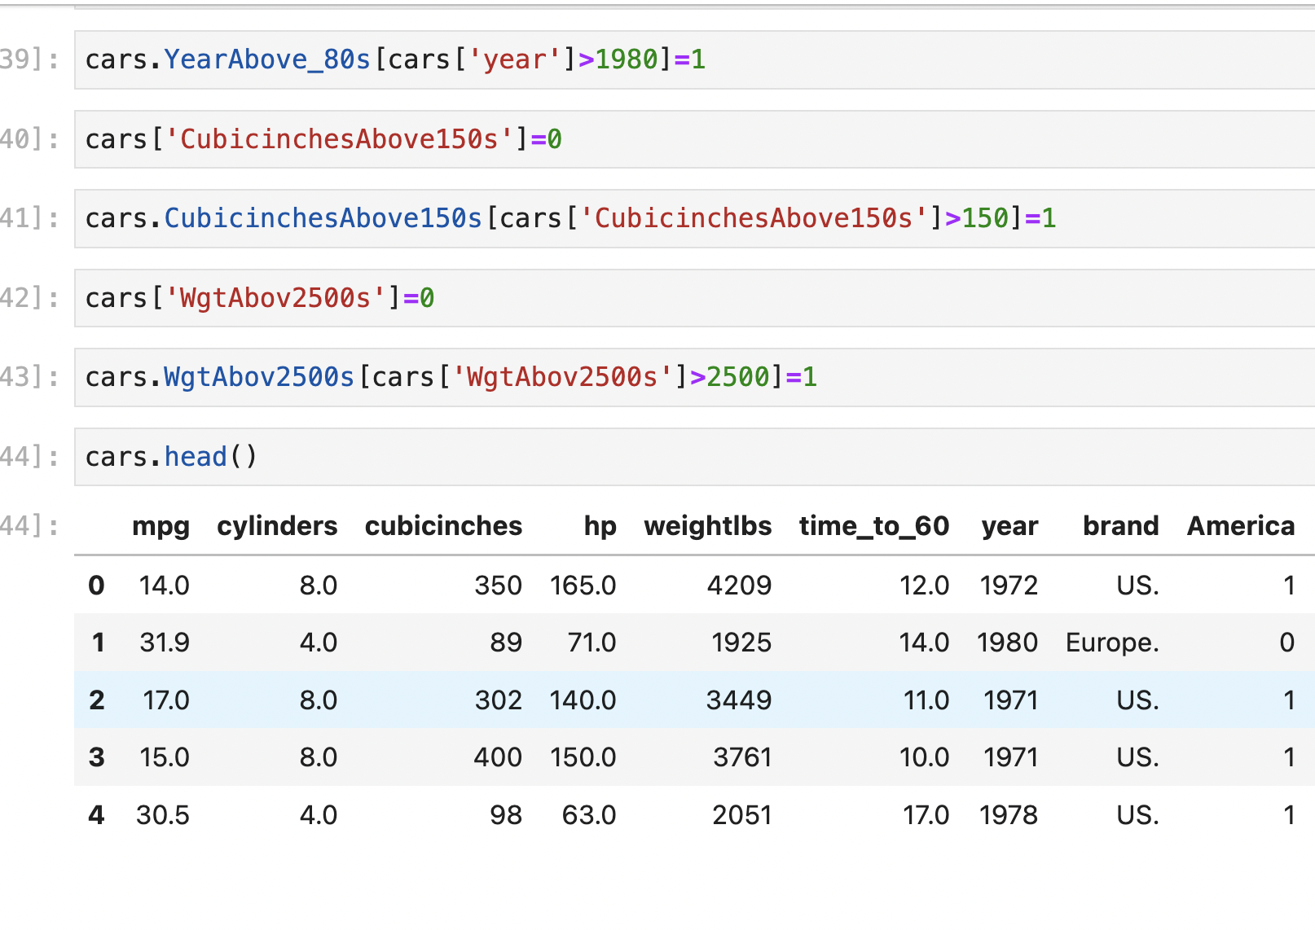
Logistic Regression
1) Can we build a model to predict which cars are American based on the reported features of the vehicle?
Constructing A New Binary Variable

Slide 10
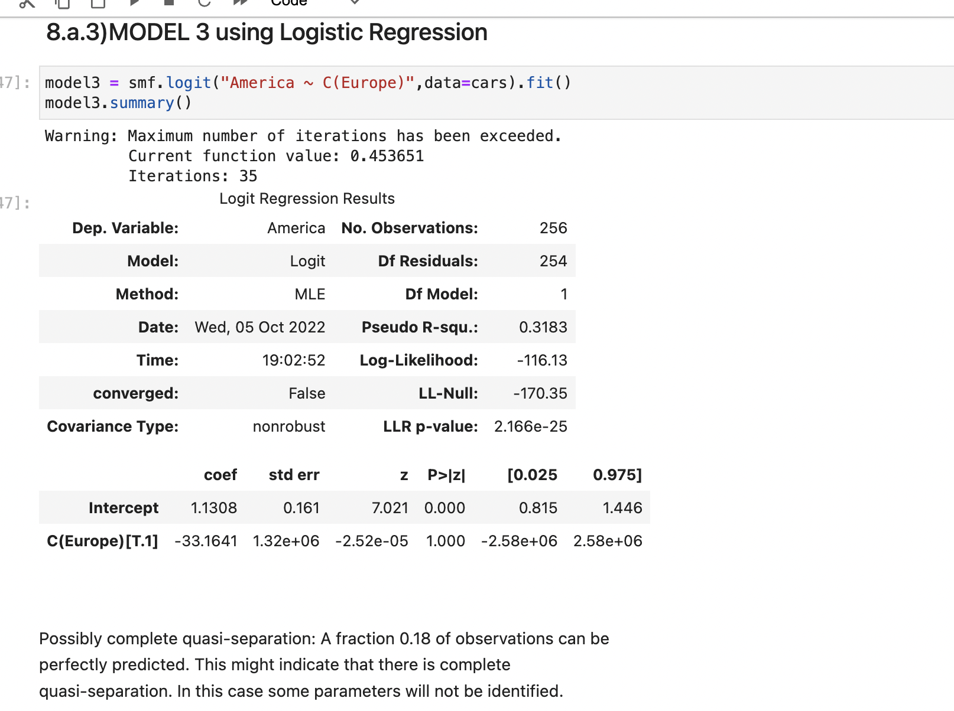
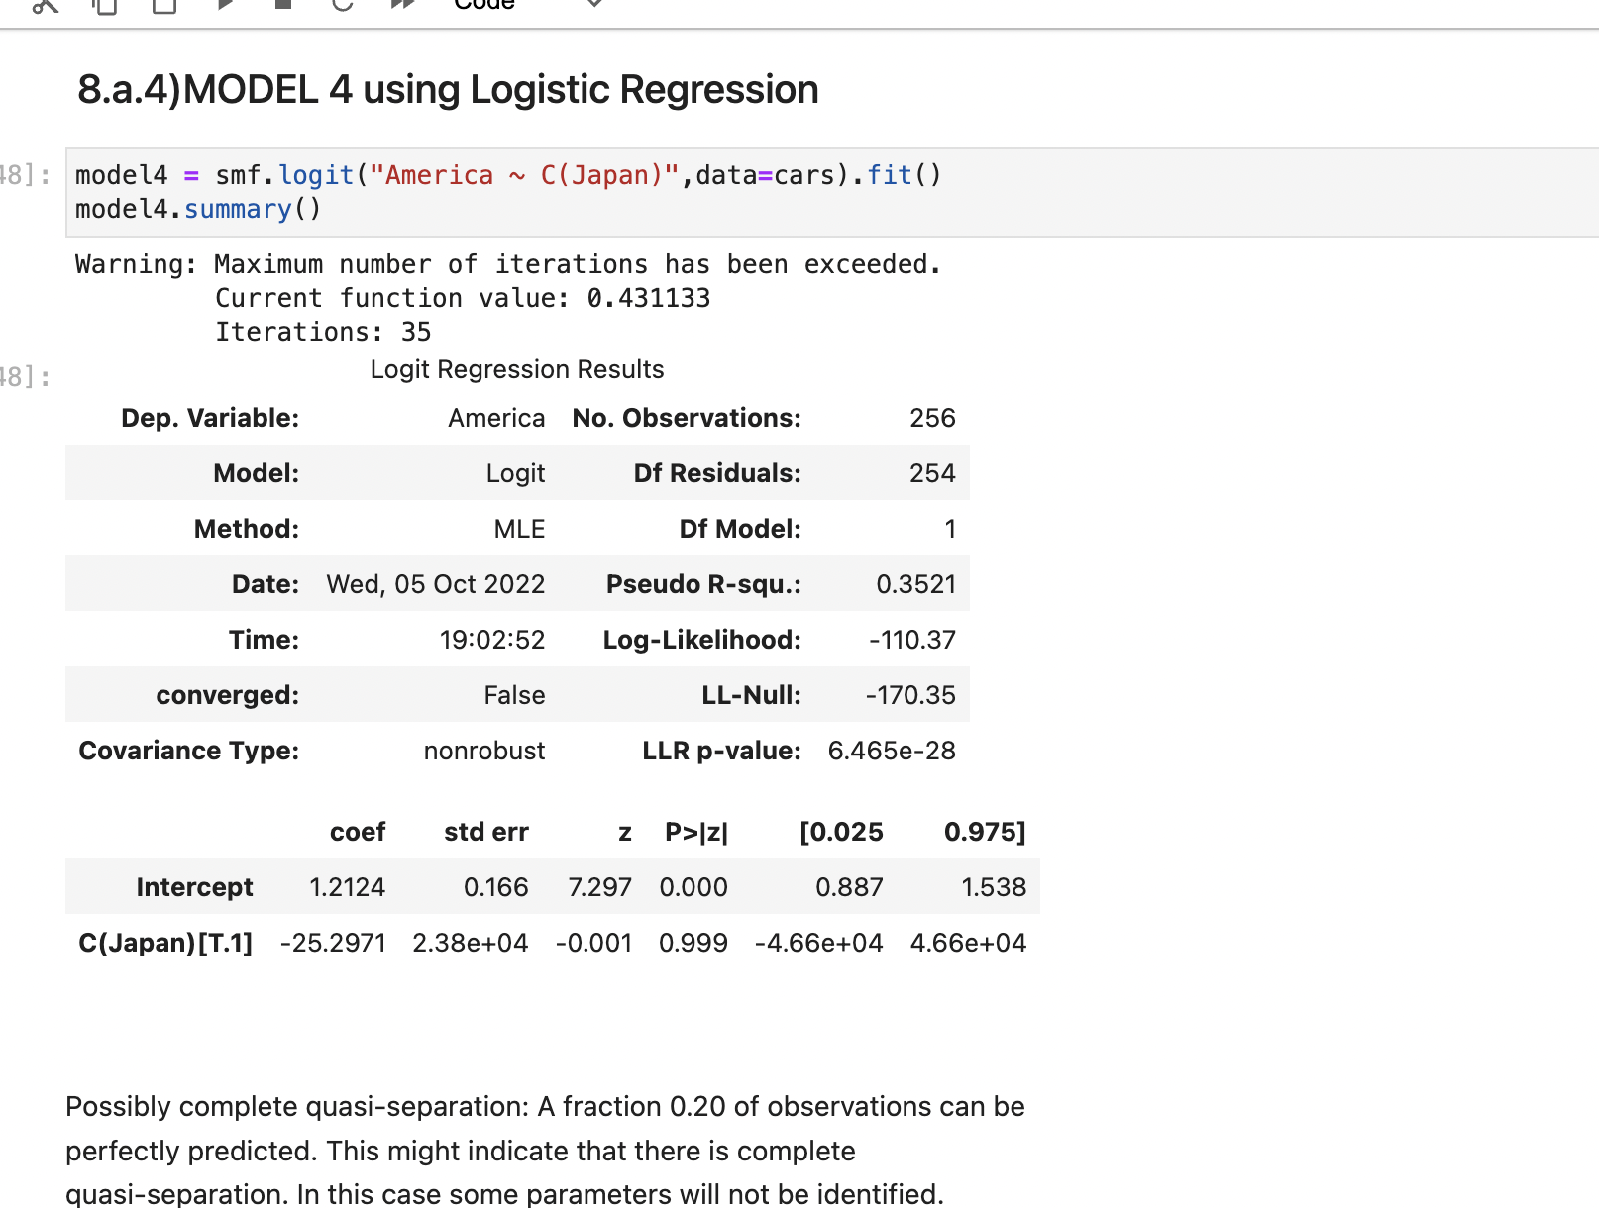
Logistic Regression
2) Predicting Model’s

Slide 11
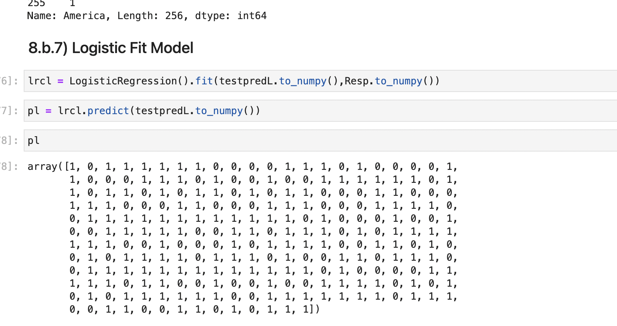
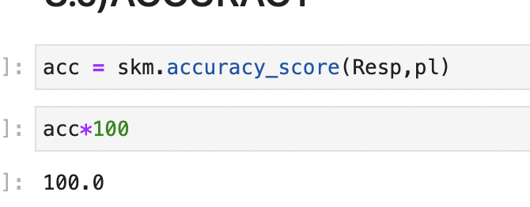
Logistic Regression
3) Logistic Model And Accuracy
Accuracy Is How Close The Predicted Values Are To The Expected Value.
Our Accuracy Is 100% , Which Match’s The Expected Value.
Performance Evaluation Metrics For A Classification Model Is Better.

Slide 12
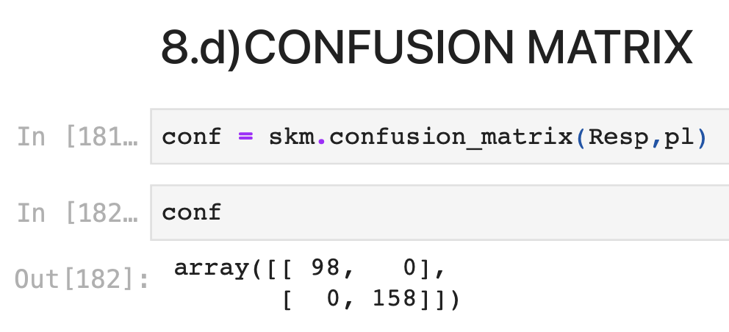
Logistic Regression
4) Confusion Matrix
N Is The Number Of Target Classes, And A Confusion Matrix Is A N X N Matrix Used To Assess The Effectiveness Of A Classification Model.
Our True negative value is 98,
True Positive value is 158.
Our False Positive value is 0,
False Negative value is 0.

Slide 13
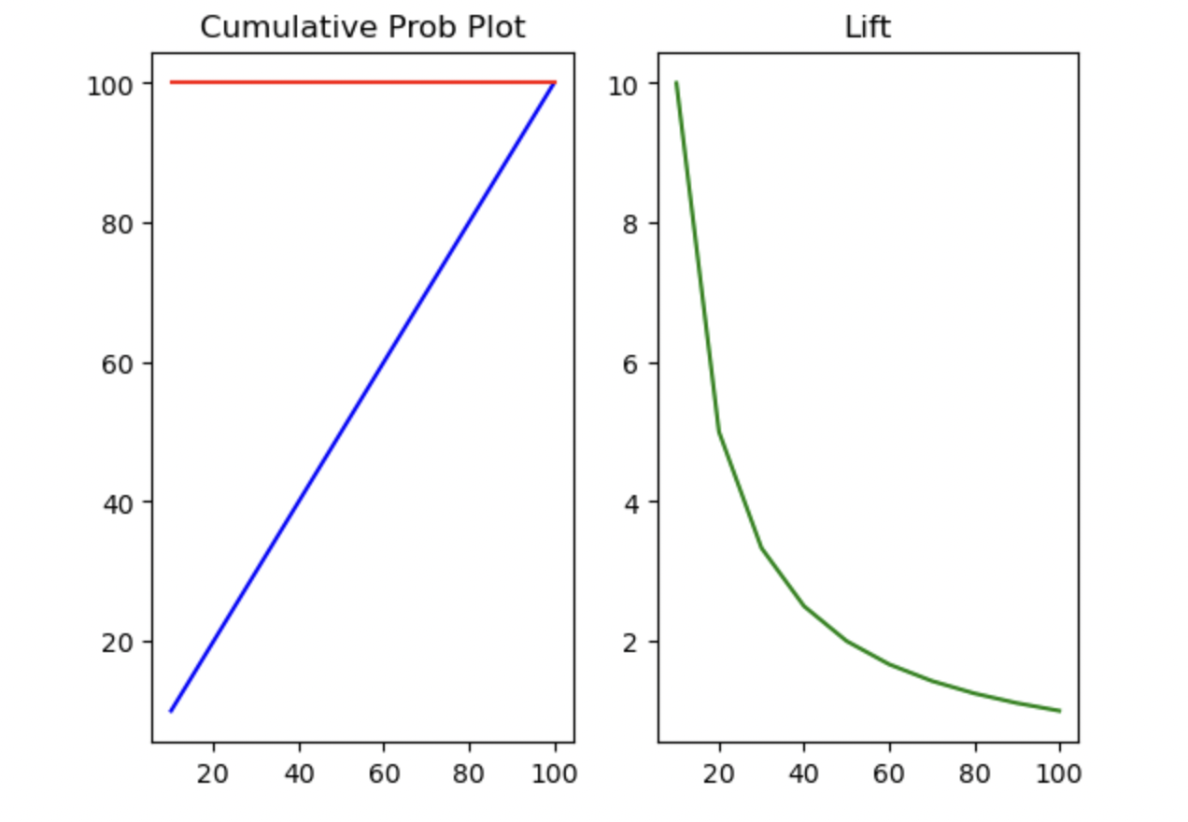
Logistic Regression
5) Cumulative Probability Chart And Lift
Two Roughly Comparable Visual Tools For Evaluating The Efficacy Of A Predictive Classification Algorithm Are Cumulative Gains And Lift Curves.
The Area Under The Curve (Auc), Which Offers An Aggregate Measure To Assess Model Performance Over All Feasible Classification Thresholds, Is The Statistic That Is Typically Used To Summaries A Roc.

Slide 14
XG BOOST Classifier
3

Slide 15
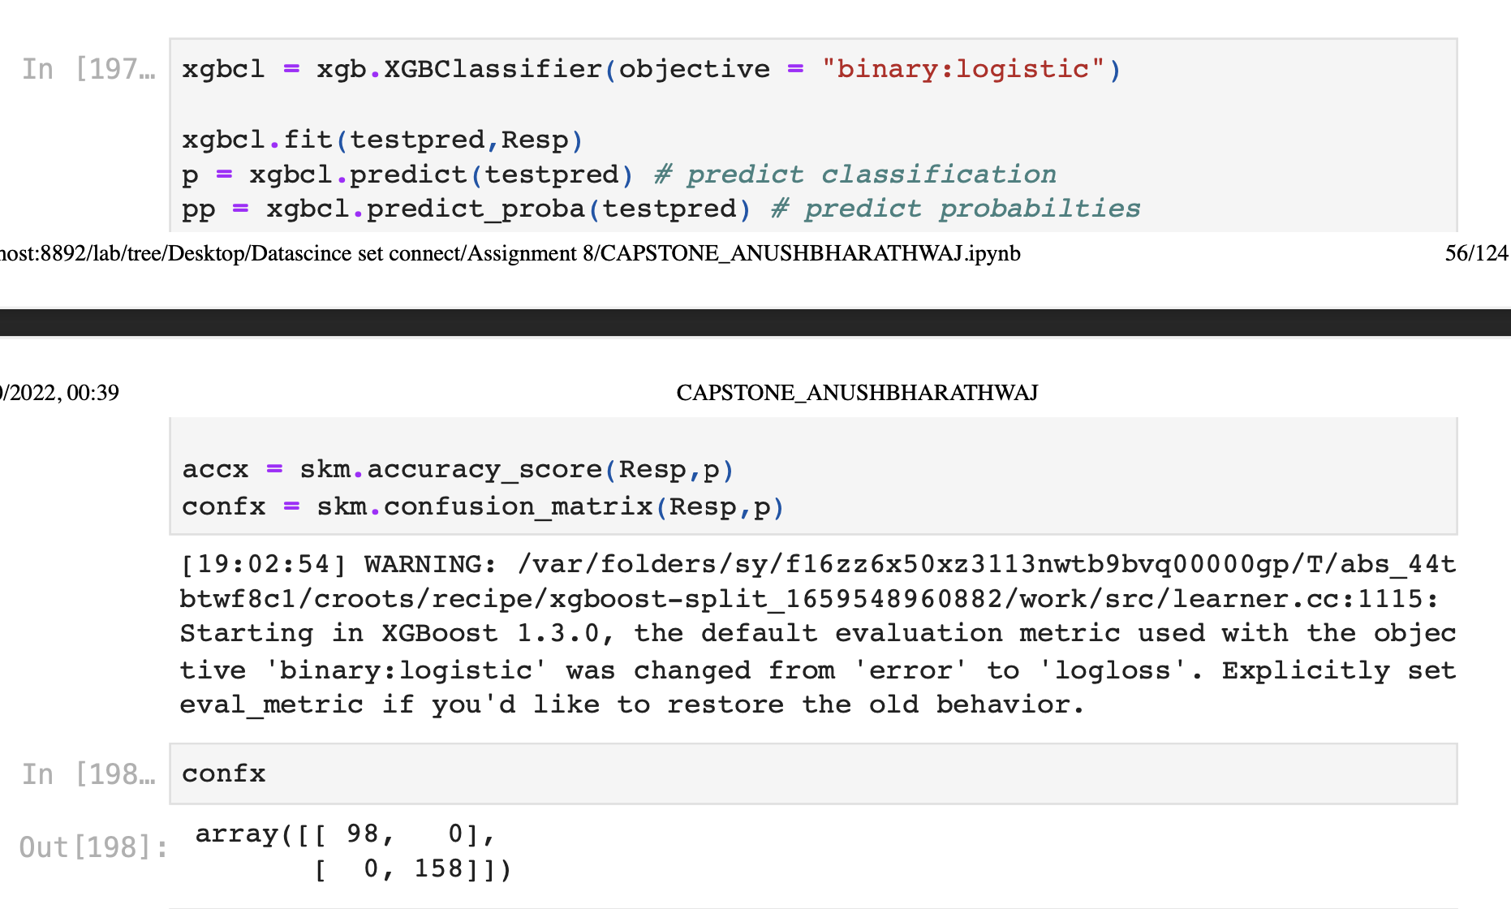
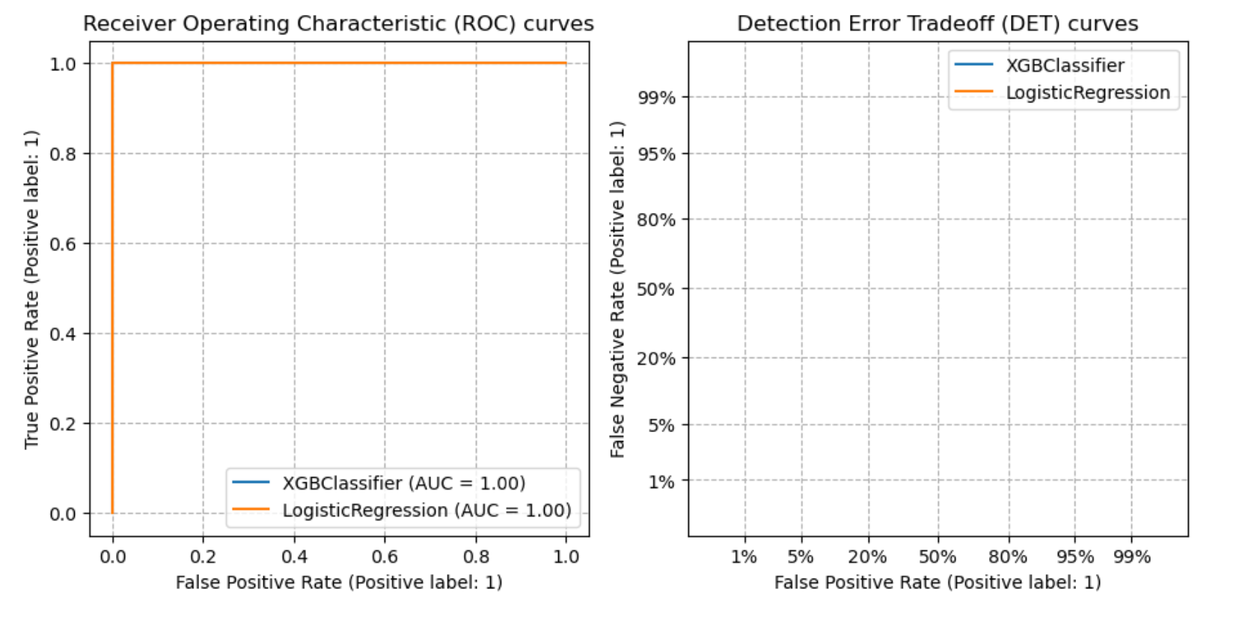
Classifier
1) XGBOOST Classifier

Slide 16
Linear Regression
4

Slide 17
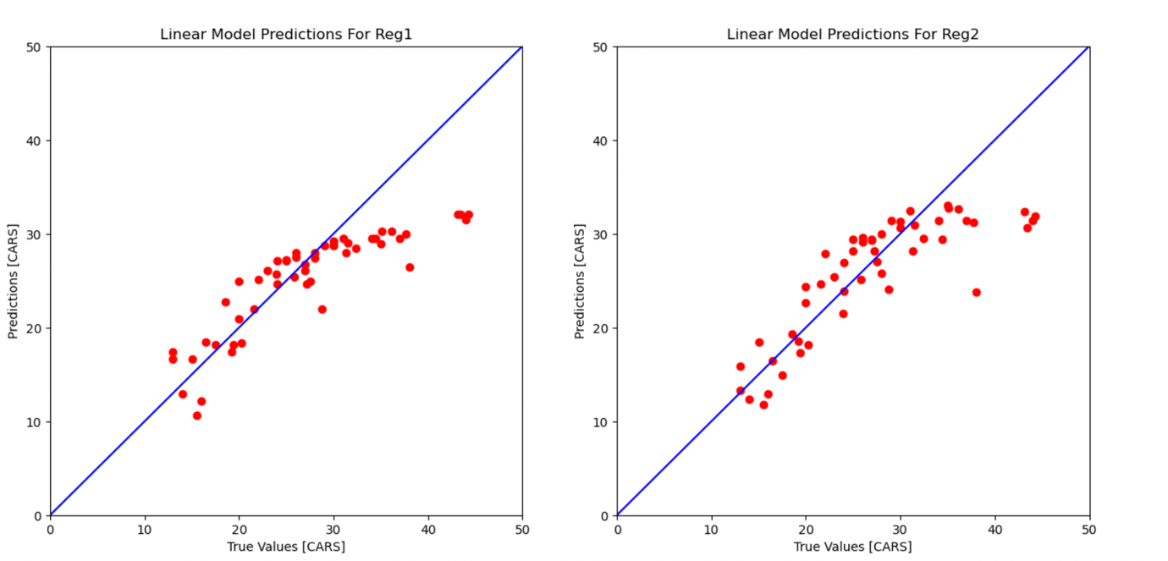
Linear Regression
1) Produce A Plot Of The True Values (X-axis) Vs Your Model’s Predicted Values (Y-axis) For Linear Regression.
THE VARIABLE'S ANTICIPATED VALUE IS THE VALUE DETERMINED BY THE REGRESSION ANALYSIS.
THE TERM "RESIDUAL" REFERS TO THE VARIATION BETWEEN THE ANTICIPATED REGRESSION VALUE AND THE ACTUAL VALUE. REGRESSION ANALYSIS MAKES A NUMBER OF KEY ASSUMPTIONS, ONE OF WHICH IS THAT THE RESIDUALS HAVE A NORMAL DISTRIBUTION WITH A MEAN OF 0, MEANING THAT BOTH POSITIVE AND NEGATIVE RESIDUALS ARE REQUIRED.

Slide 18
Non-Linear Regression
5

Slide 19
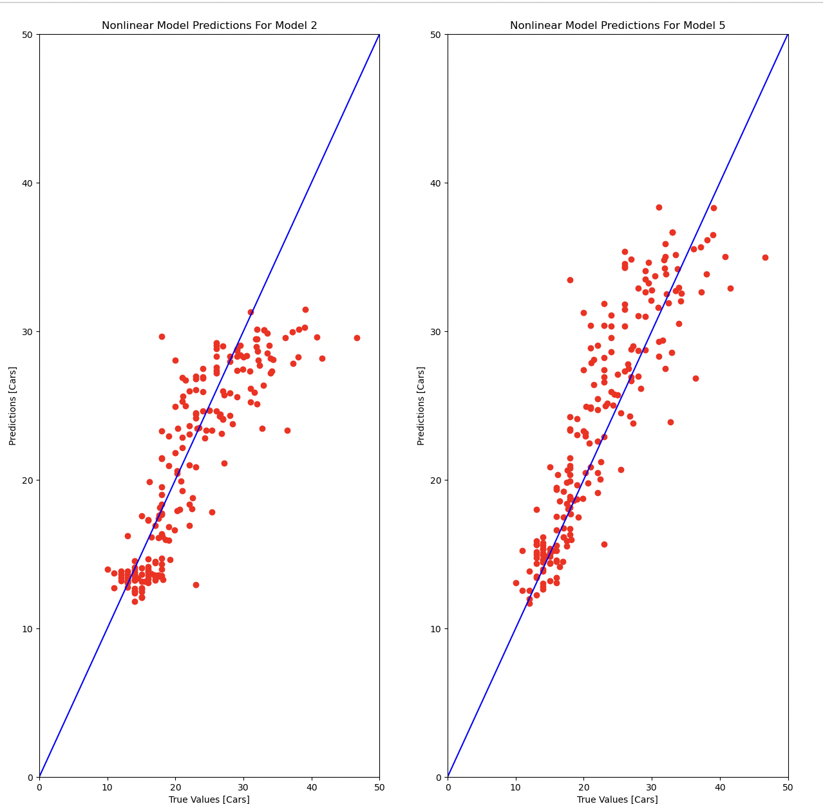
Non Linear Regression
1) Produce A Plot Of The True Values (X-axis) Vs Your Model’s Predicted Values (Y-axis) For Non-Linear Regression.
An Indicator Of How Far The Y Observations Deviate From The Nonlinear (Curved) Function That Is Used To Forecast Y Is The Sum Of Squares.
Similar To Linear Regression Modelling, Nonlinear Regression Modelling Aims To Visually Monitor A Certain Response From A Collection Of Factors.
Because The Function Is Constructed By A Series Of Approximations (Iterations) That May Result From Trial-and-error, Nonlinear Models Are Trickier To Design Than Linear Models.

Slide 20
Conclusion For Business Value
6

Slide 21
Conclusion
Significance Of Our Findings And Recommendations
Well we’ve achieved what we set out to achieve. We have a fairly accurate linear regression model that will take in features of a car based on brands America(USA) with a fair amount of accuracy.
I think the intriguing conclusions we came to through our EDA are more fascinating. I mean, I'm certainly pleased to give it to you.
Correlation analysis determines how well a connection is fit by a straight line by examining the degree of association between two continuous variables.
MPG is 66% greater in manual gearbox vehicles.

Slide 22
Feedback And Interest
7

Slide 23
Credits
Experience
I Have Endless Recollections From This Program's Weekly Fresh Lectures From Set Connect. I Gained Knowledge About Logistic Regression As Well As Linear And Non-linear Regression.
Regarding The Tasks And Activities In The Set Connect, My Primary Drive For Joining The Initiative Is To Expand My Horizons Beyond My Primary Area Of Study.
Well, Machine Learning Is More Theoretical For Me Than It Is Useful. Machine Learning Coding Is Simple Because To The Abundance Of Machine Learning Libraries That Have Previously Been Developed. However, True Machine Learning Involves Creating Your Own Models.
The One We've Learned Is Neural Network Modelling, Which Is Image Data Classification. That Is, In A More Precise Manner And By Forecasting The Model's Accuracy For The Expected Value.
Data Visualization Has Grown To Be An Essential Tool For Decision-makers Because Large Numbers Are So Challenging To Understand In Any Meaningful Way Yet Many Of The Most Valuable Data Sets Contain Enormous Volumes Of Relevant Data. My Abilities And Potential Knowledge Have Improved As A Result Of Using Ggplot And Tableau.
I Found A Lot Of Things Enjoyable. This, In My Opinion, Is Preferable Than Studying Predictive Modelling Using Data Through Textbooks Or Reading Academic Articles.

Slide 24
THANKS!

